Slide 1
Loadout Locker
Anirudh Gopishankar
Yohan Amaratunga

Slide 2
Situation and solution
Situation: Gamers across multiple platforms find it difficult to track things like Progress, In-game settings and achievements across various platforms and games.
Solution: Loadout Locker is a dashboard that provides that manages both PC In-game settings and console game progression as well

Slide 3
Technical execution
Environment Setup: Successfully configured Flutter SDK on MacOS with VS Code integration.
Successfully Validated Flutter Environment using a “Hello World” counter app, executed via a local web server to bypass Xcode dependency.
Developed a multi-level stateful application using the Dart Language.

Slide 4
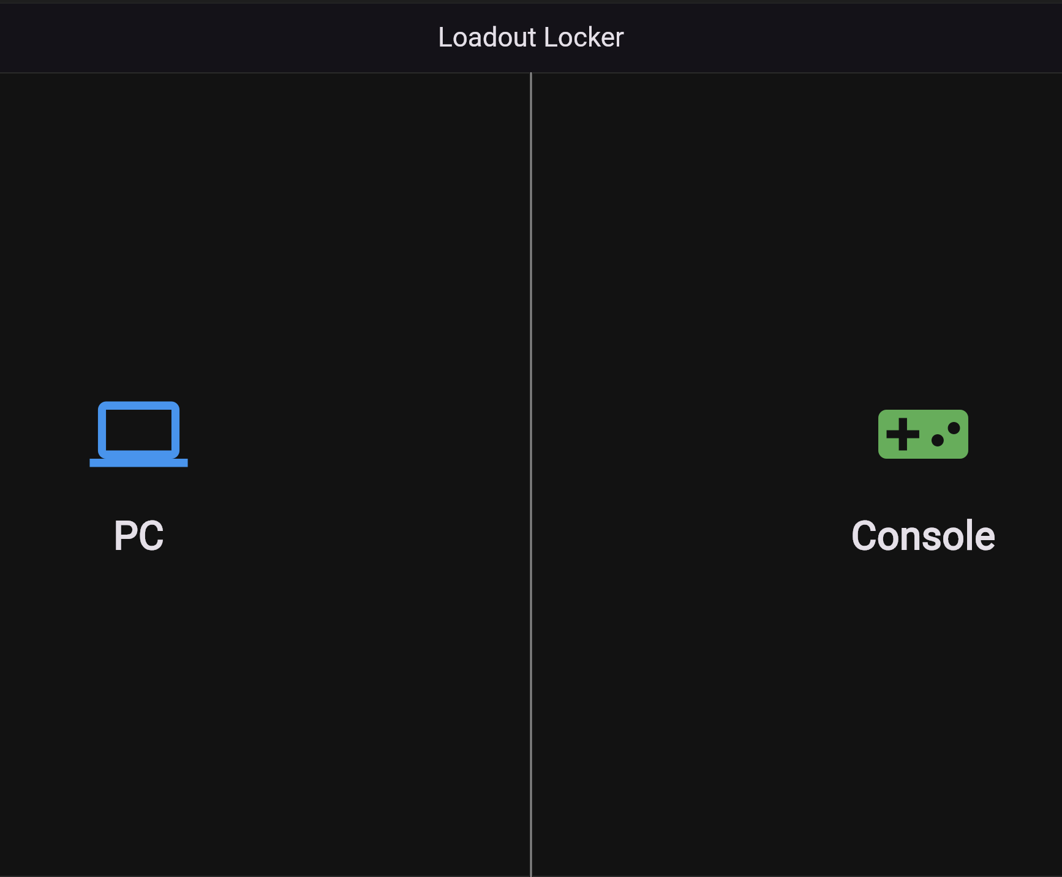
Key features Demo Part 1
Dual Platform AI: A side by side block layout for PC and Console categories.
Helps with making sure that people with both hardware can use the same dashboard.

Slide 5
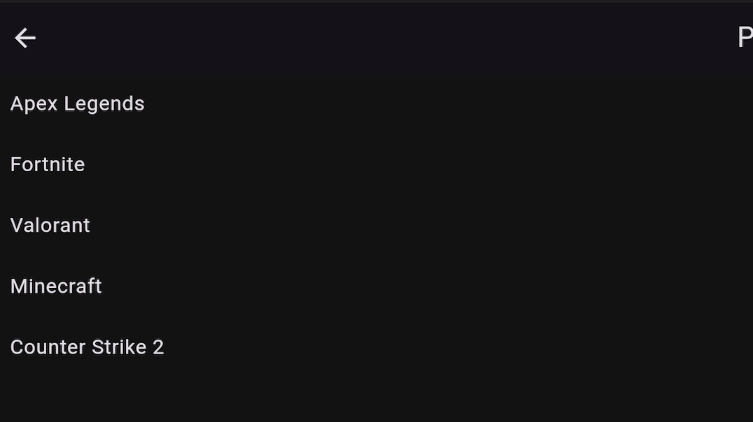


Key features demo part 2
PC Profiles: Custom input fields for DPI, sensitivity and Graphics Settings.
DPI and Sensitivity take Numeric values and Graphics settings take 4 settings:
Low
Medium
High

Slide 6
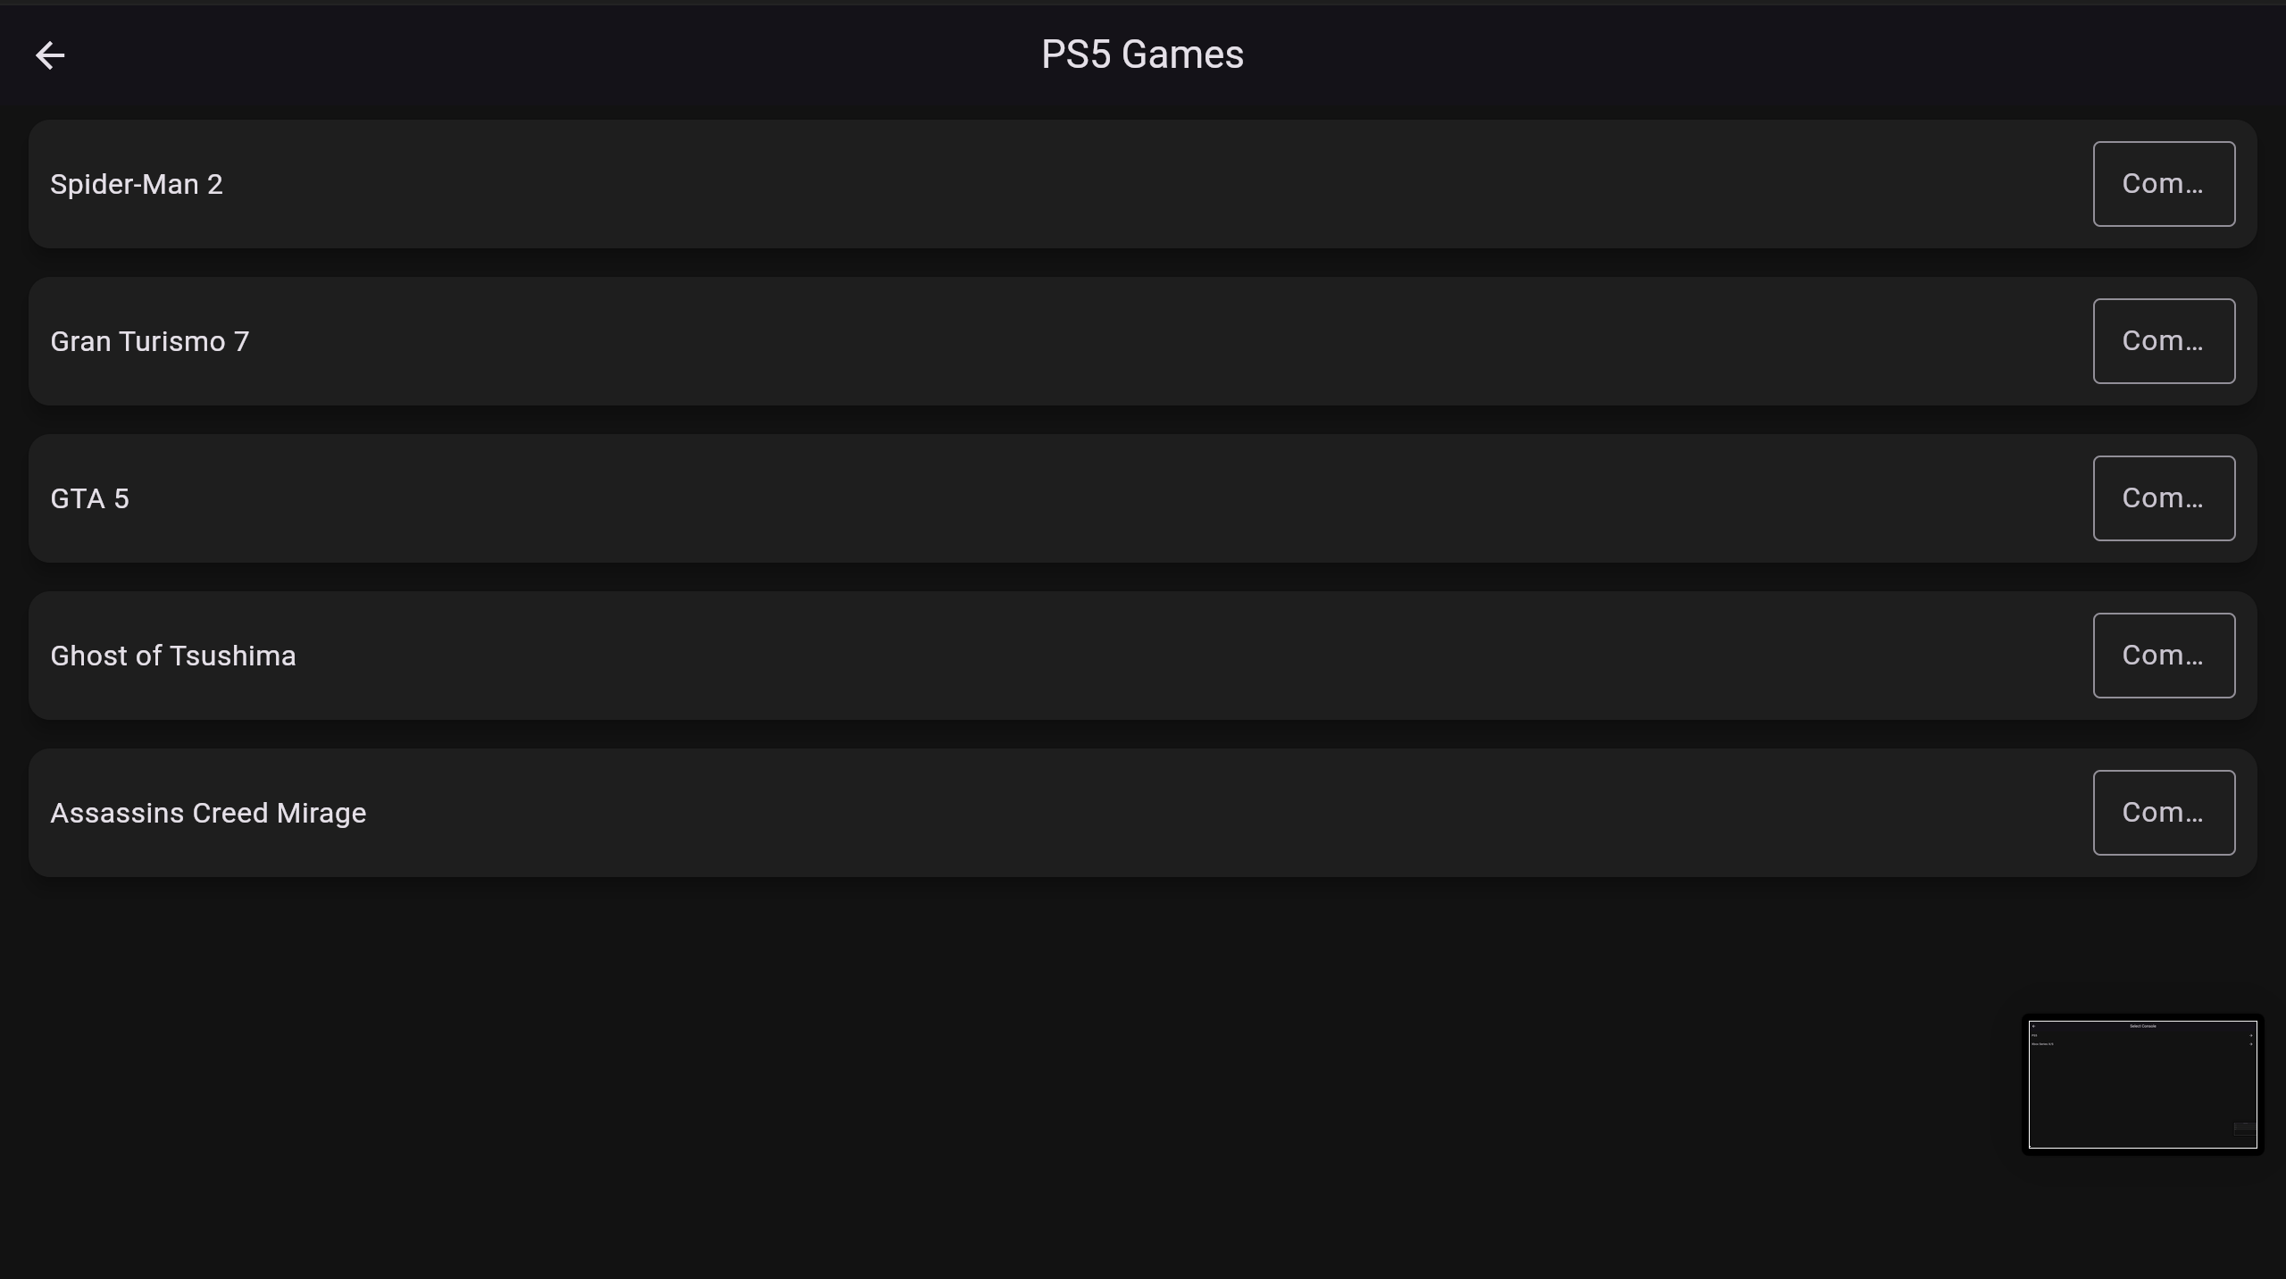
Key features demo part 3
Console tracking: Interactive tracking for game progress
Within the Console page there are 2 different sections for Xbox and Playstation.

Slide 7
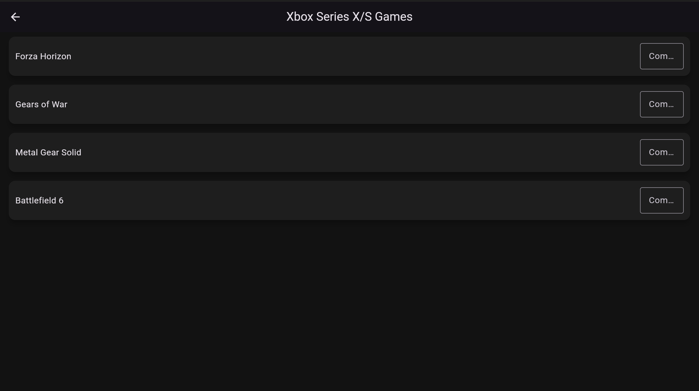

Slide 8
Github Repository
Link: https://github.com/anirrudhgg/Operating-Systems-Web-Computing_Project.git
Contents of Github:
1. Source Code (Github written and VS Code).
2. Hello World (screenshots and source code of the hello world).
3. Screenshots of Loadout Locker.

